Slide 1


FPT SOFTWARE
Machine Learning Fundamentals
10/02/18

Slide 2
Supervised Learning
Lecture 2: Supervised Learning
Outline:
Classification and Regression
Inductive Learning
Decision Trees
Bayesian Learning
Neural Networks
Model Ensembles
Learning Theory
Support Vector Machine
Project Assignment

Slide 3
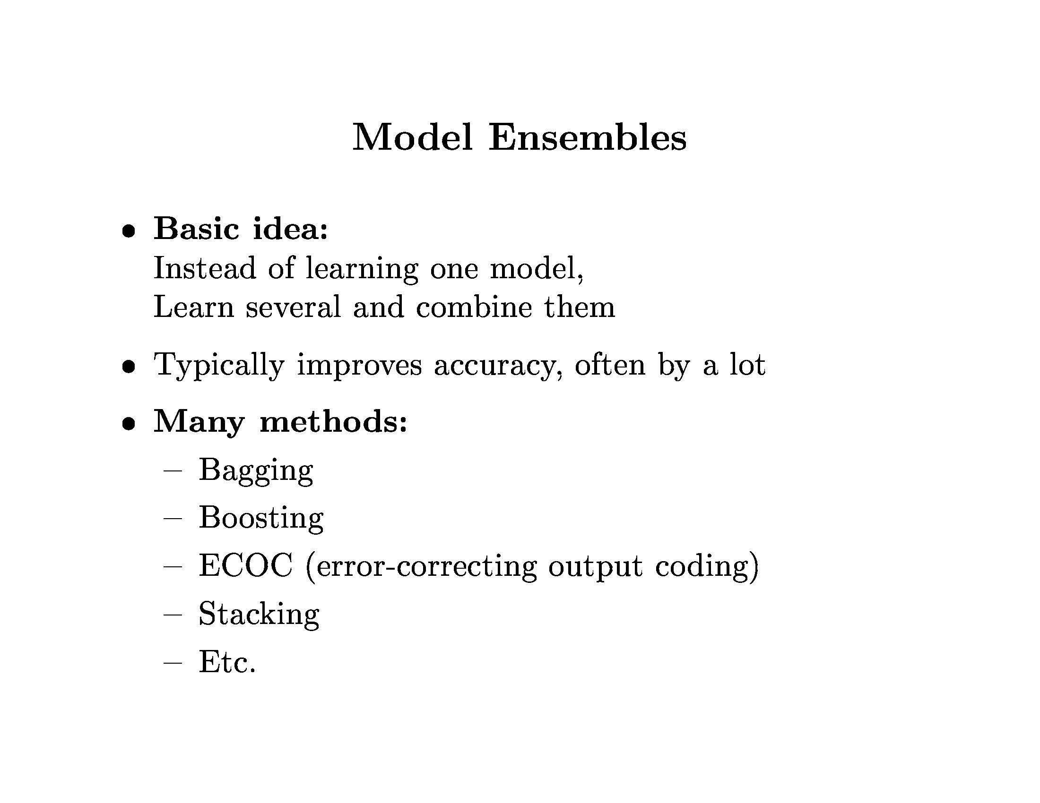
Model Ensembles

Slide 4
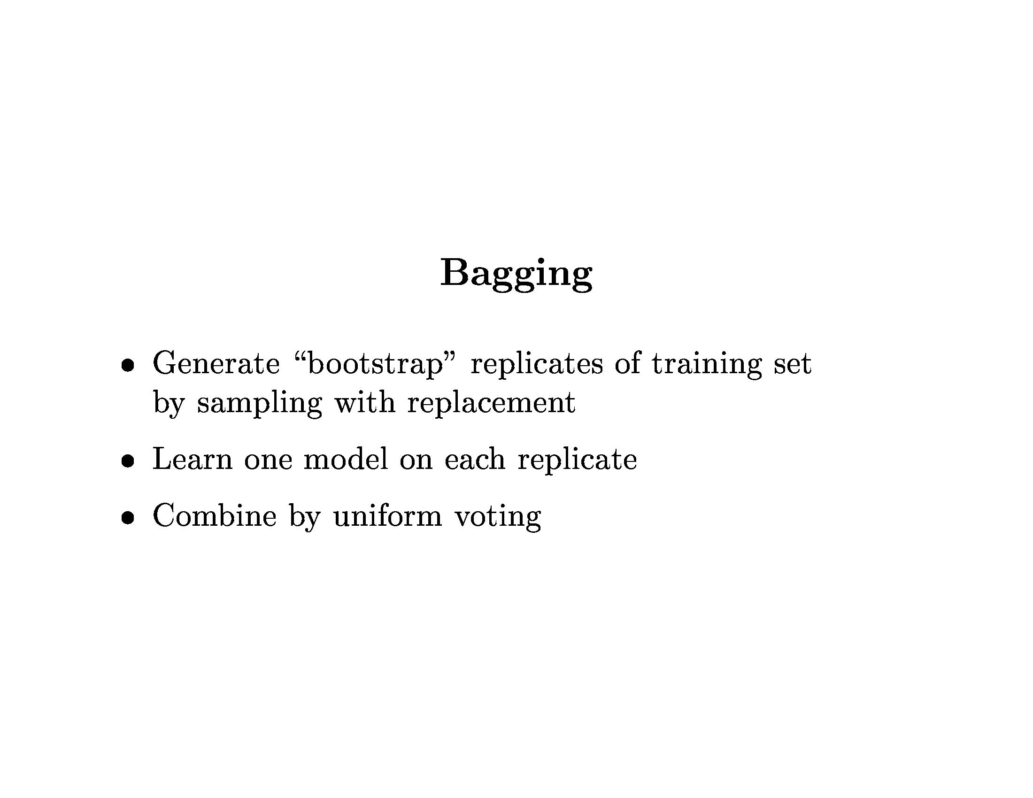
Model Ensembles

Slide 5
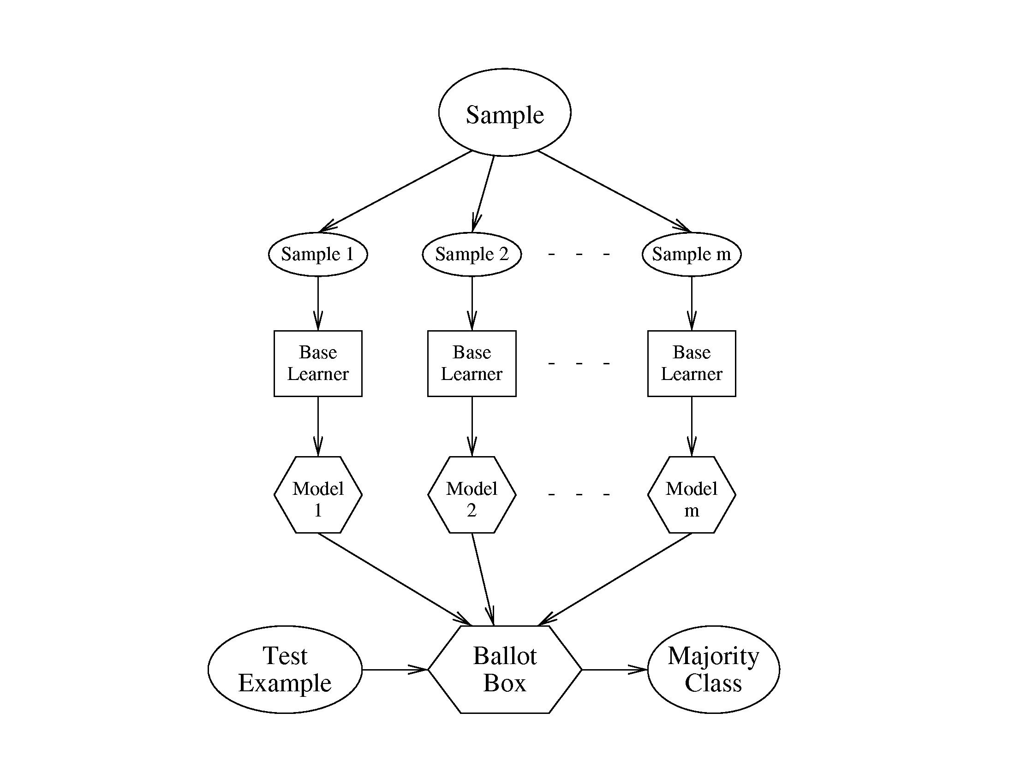
Model Ensembles

Slide 6
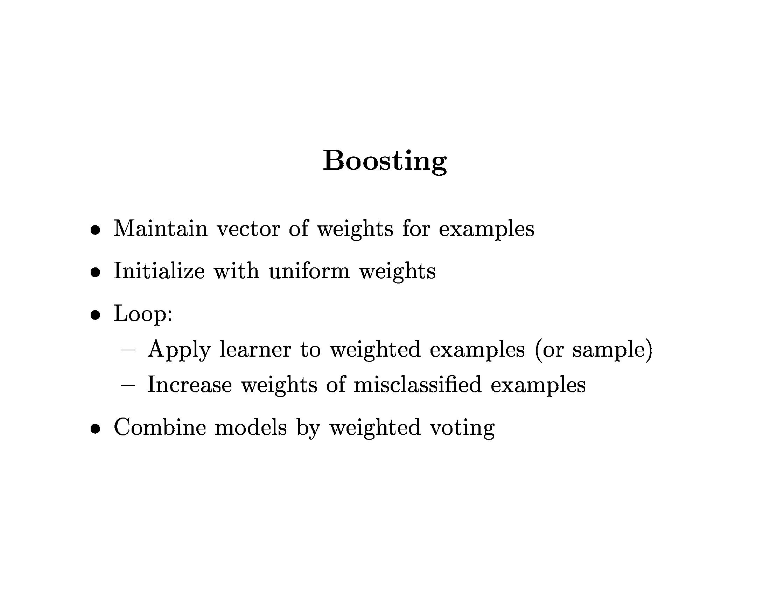
Model Ensembles

Slide 7
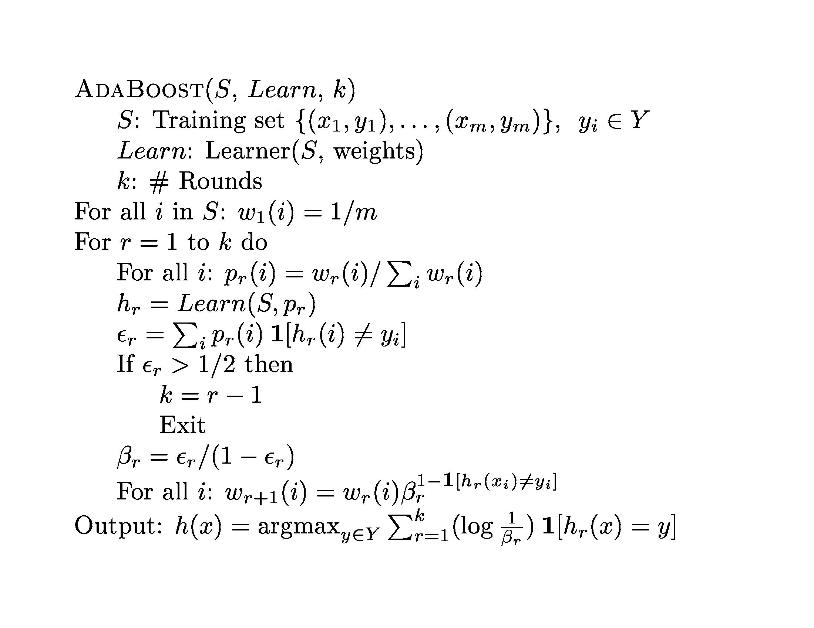
Model Ensembles

Slide 8
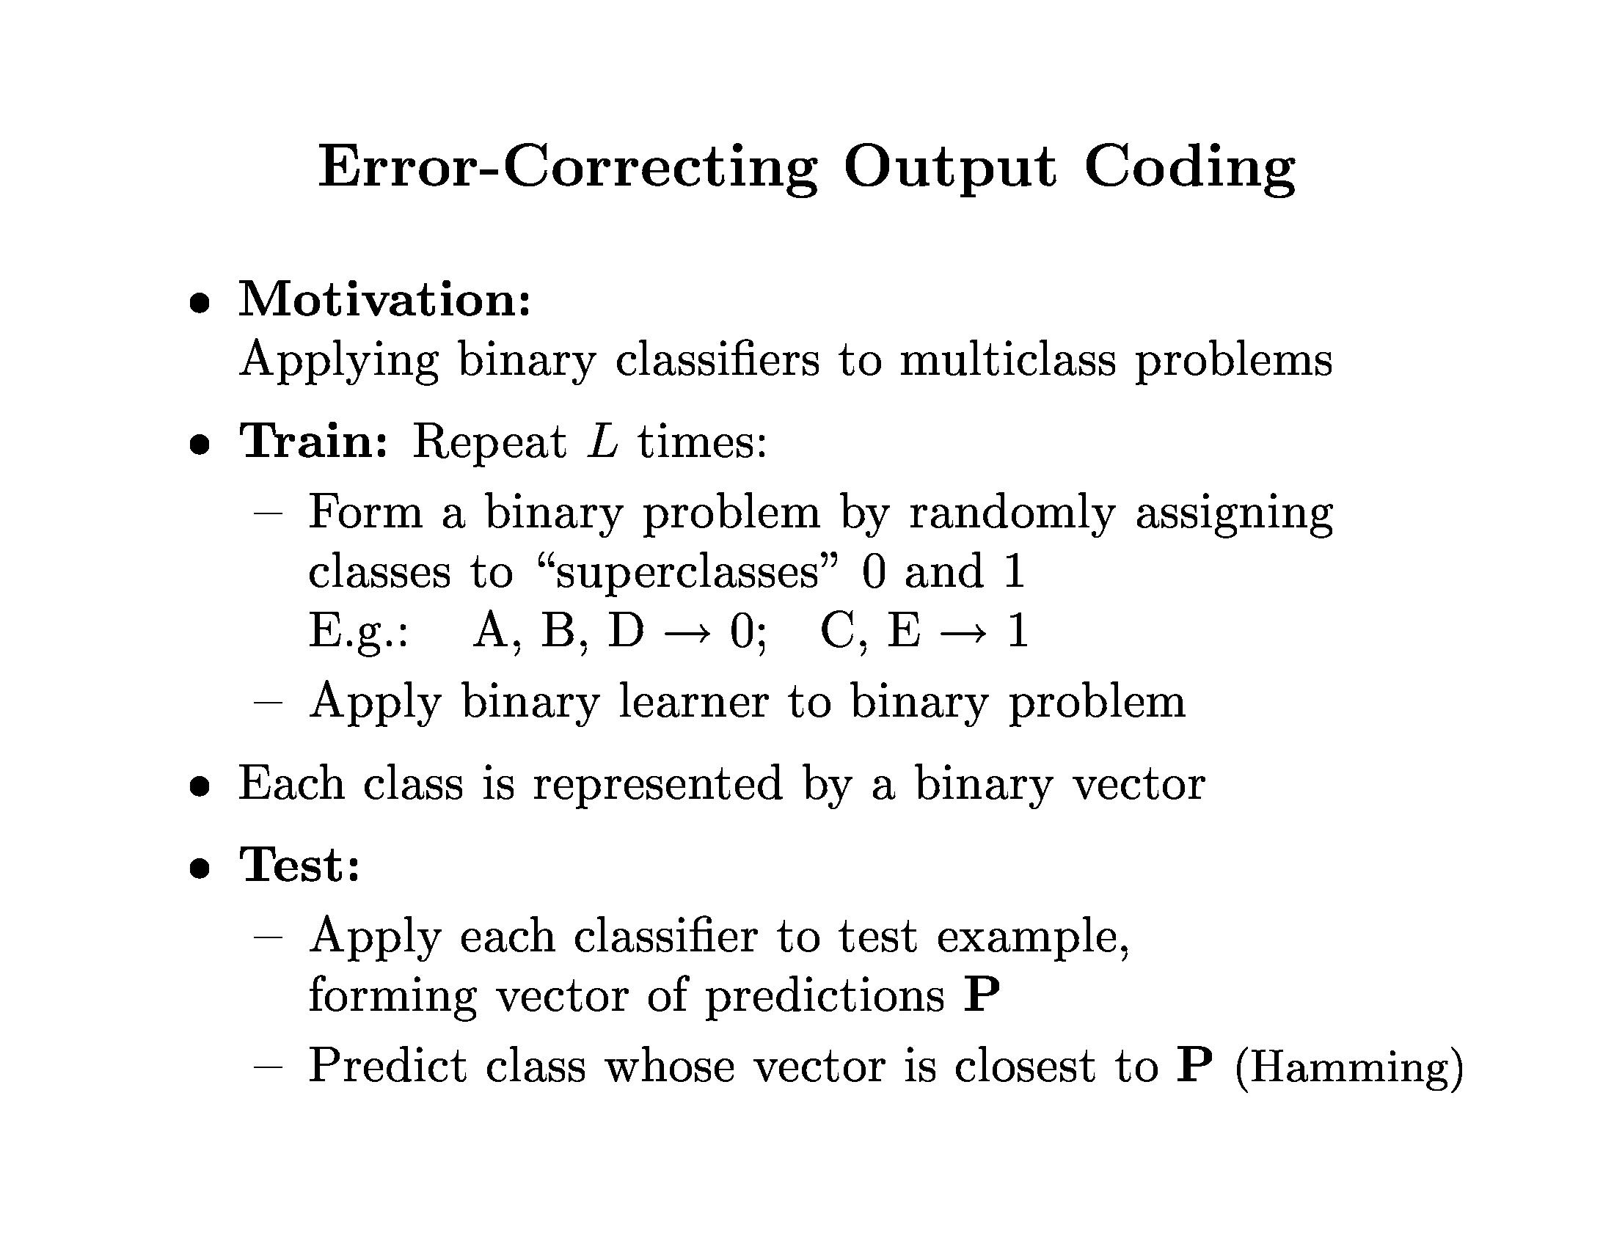
Model Ensembles

Slide 9
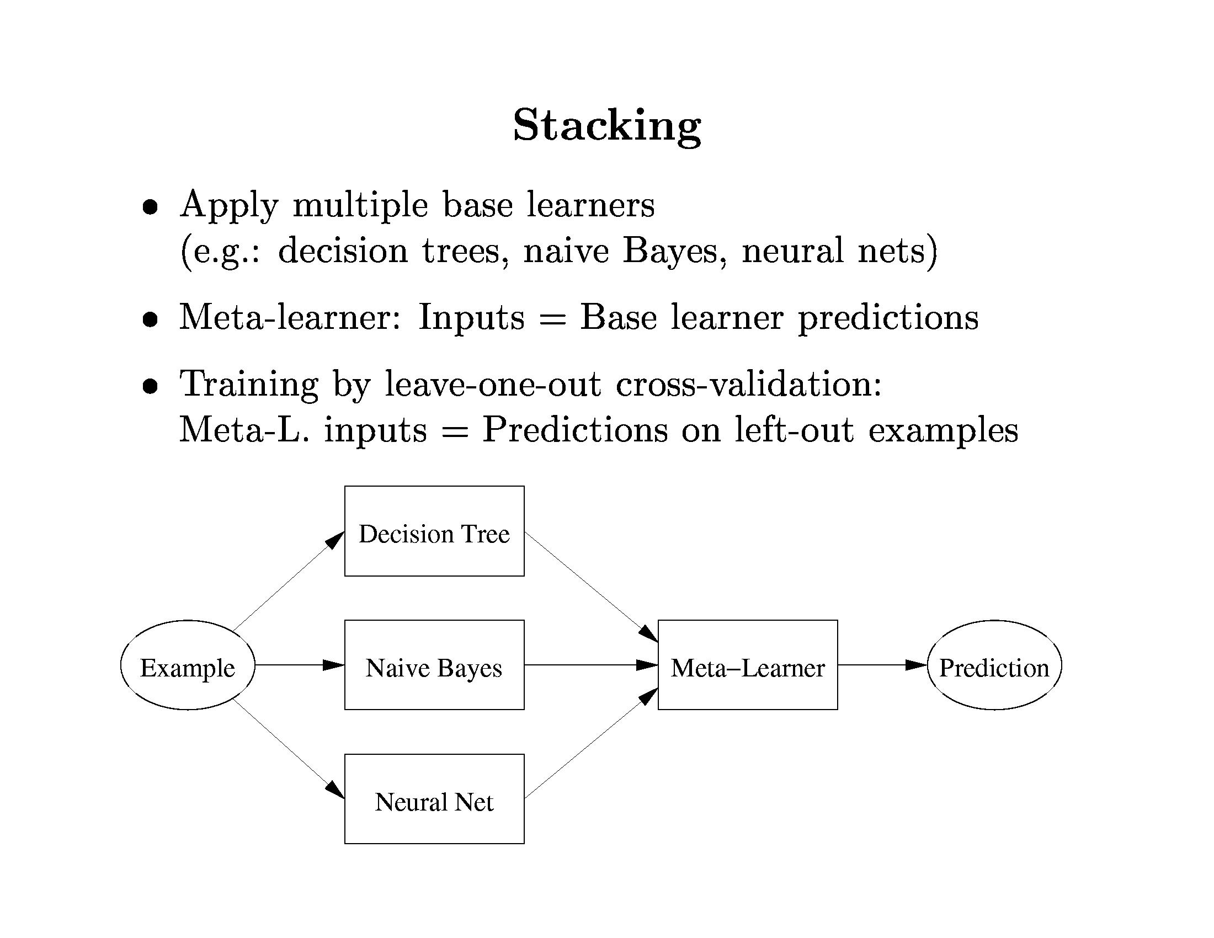
Model Ensembles

Slide 10
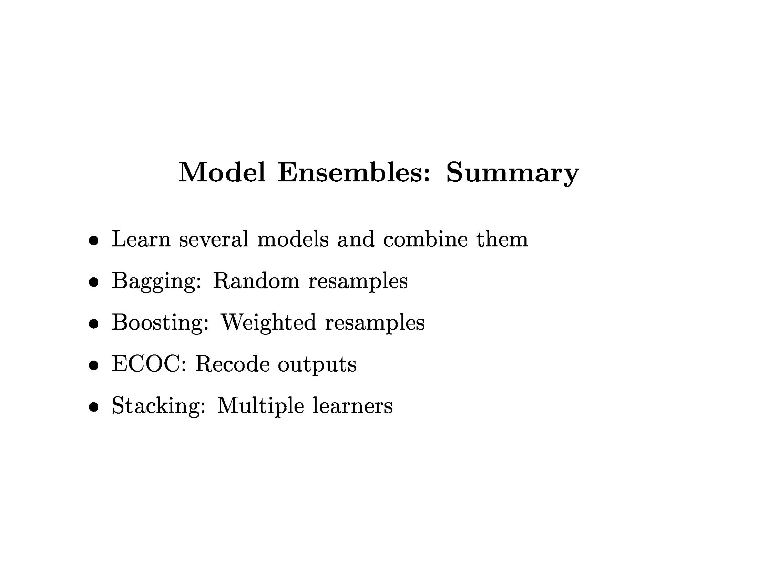
Model Ensembles

